Slide 1

EGRET uncertainty analysis: EGRETci
Robert M. Hirsch
Research Hydrologist Emeritus
March 27, 2019

Slide 2
Uncertainty analysis: WRTDS Bootstrap Test (wBT) in EGRETci package
WRTDS was developed as an exploratory data analysis method
Users liked it, but wanted formal analysis of uncertainty for the trend results

Slide 3
Based on published paper
Hirsch, Robert M., Archfield, Stacey A., and DeCicco, Laura A., 2015,
“A bootstrap method for estimating uncertainty of water quality trends”
Environmental Modelling and Software, 73, 148-166.

Slide 4
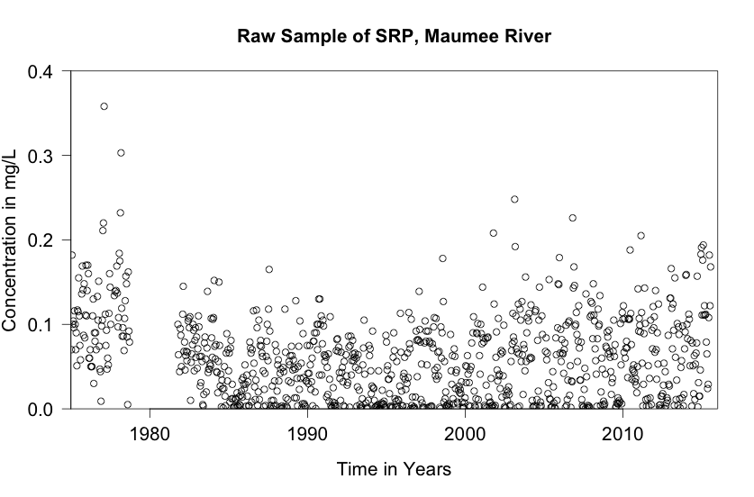


Slide 5
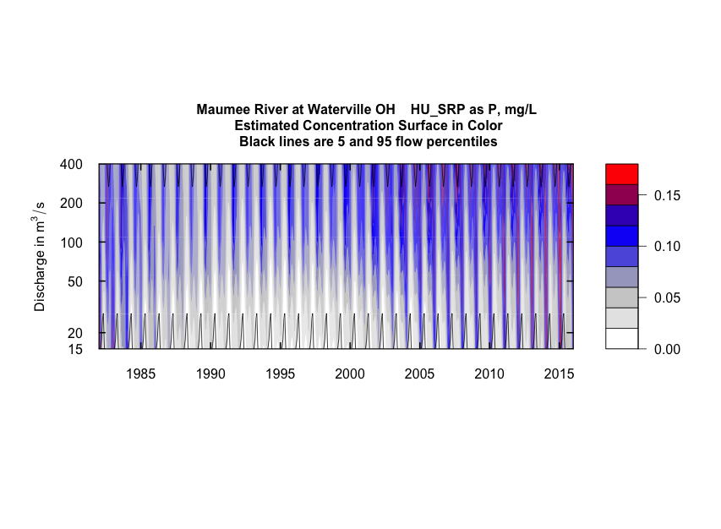

WRTDS representation of concentration as a function of time and discharge

Slide 6
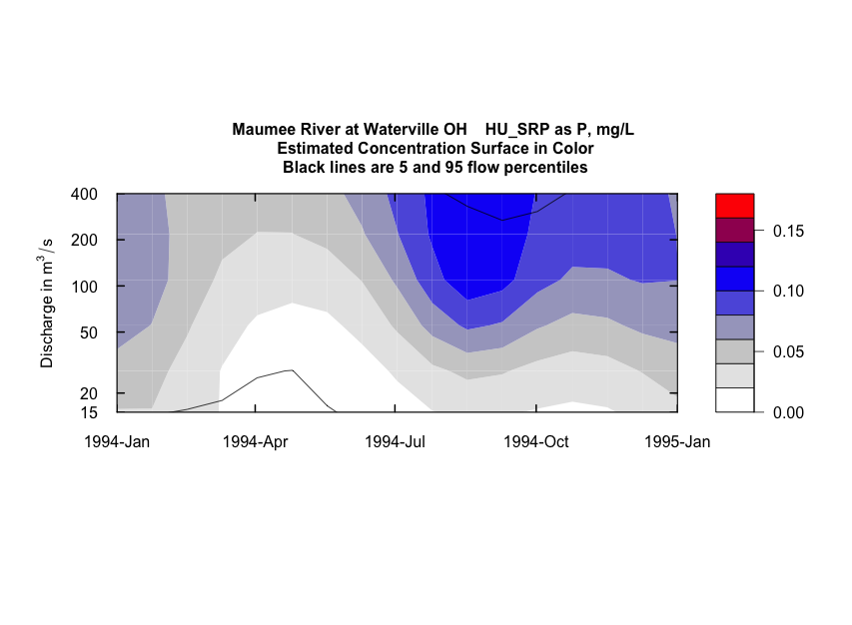
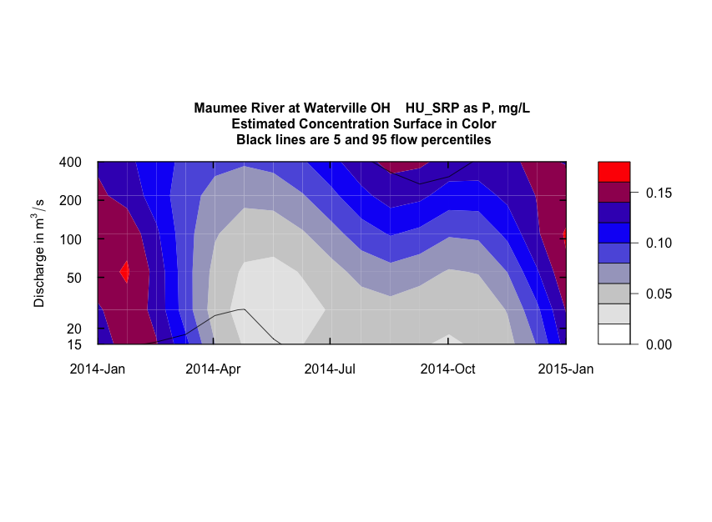
mg/L
mg/L

Slide 7
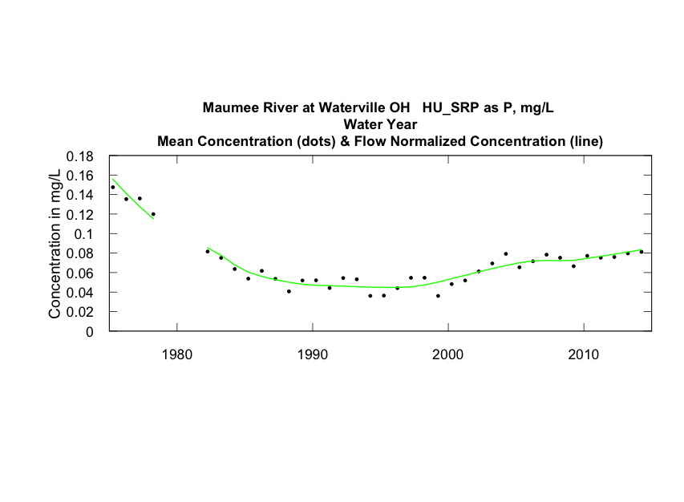
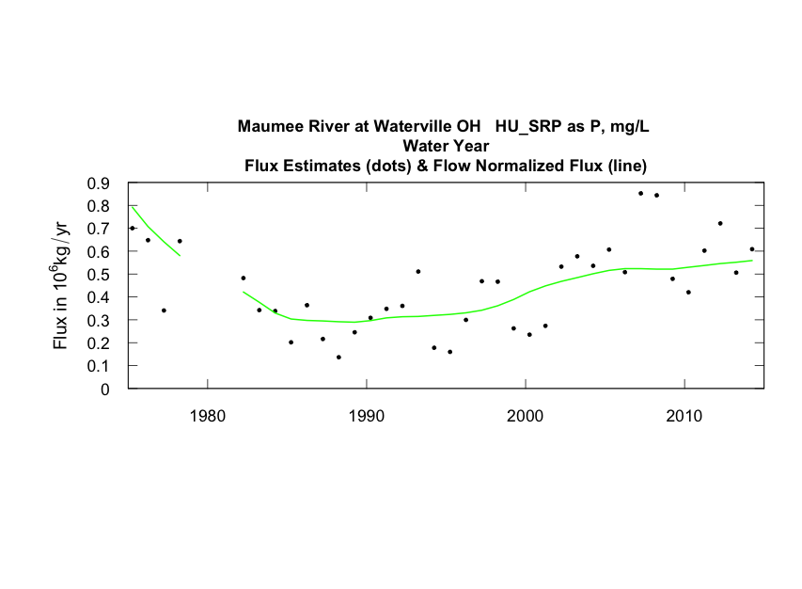

Slide 8
Use a Bootstrap method to evaluate uncertainty
Resample the data set, by 200 day blocks, with replacement
Conduct the WRTDS estimation process for each replicate determining trend magnitude on each replicate.
Uncertainty of the trend magnitude is determined from the set of bootstrap estimates.

Slide 9
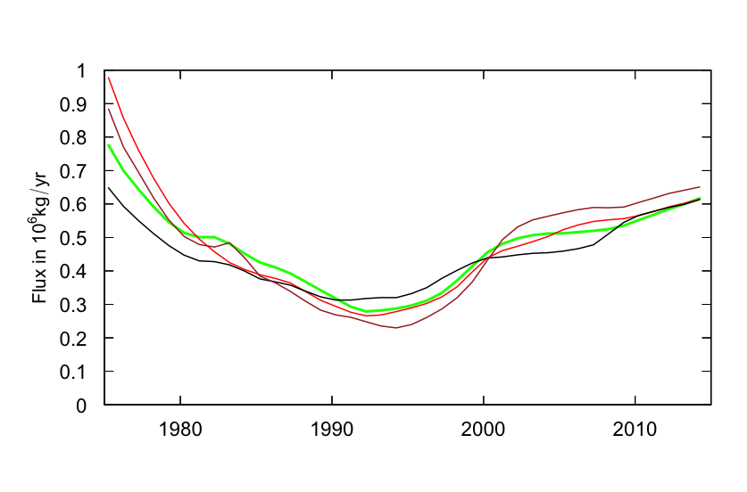
Maumee River, SRP - Green is WRTDS Flow Normalized Flux
Red, Brown and Black are three bootstrap replicate estimates of Flow Normalized Flux

Slide 10
Each bootstrap replicate can give us an estimate of change between any two years (say 1994 and 2014)

Slide 11
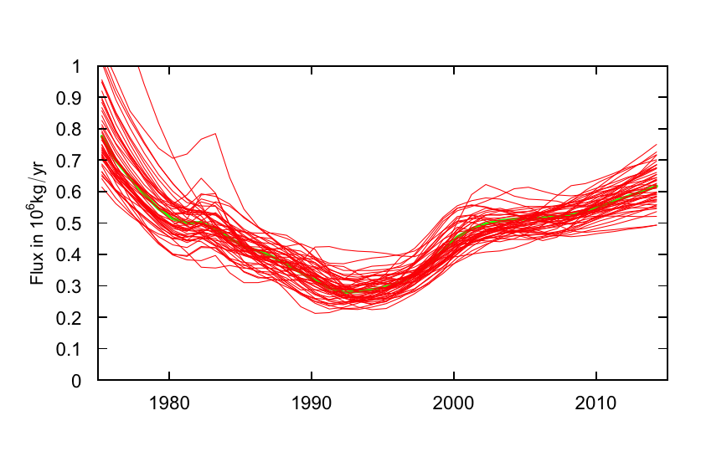
50 bootstrap replicates

Slide 12
Two ways to convey an answer to the question: Is there a trend?
Conventional p-value approach (reject H_{o} or do not reject H_{o})
Describe the results in terms of “likelihood of uptrend” or “likelihood of downtrend”

Slide 13
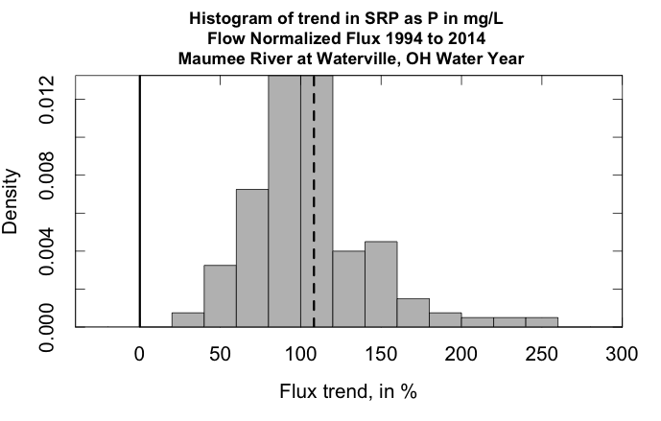
WRTDS estimate of trend
Upward trend highly likely

Slide 14
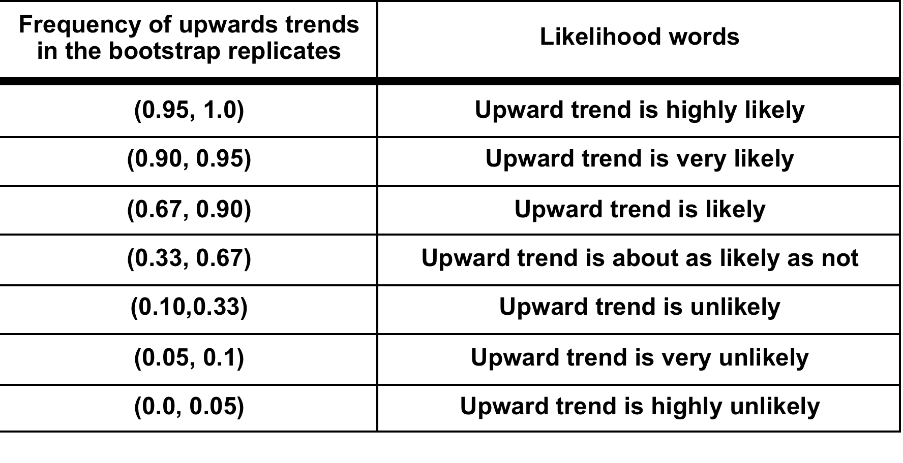
The EGRETci software translates the bootstrap results into a set of words

Slide 15
The EGRETci package can also give us confidence intervals
Various confidence intervals for the change over a specific time
Graphical confidence intervals for the entire period of record

Slide 16
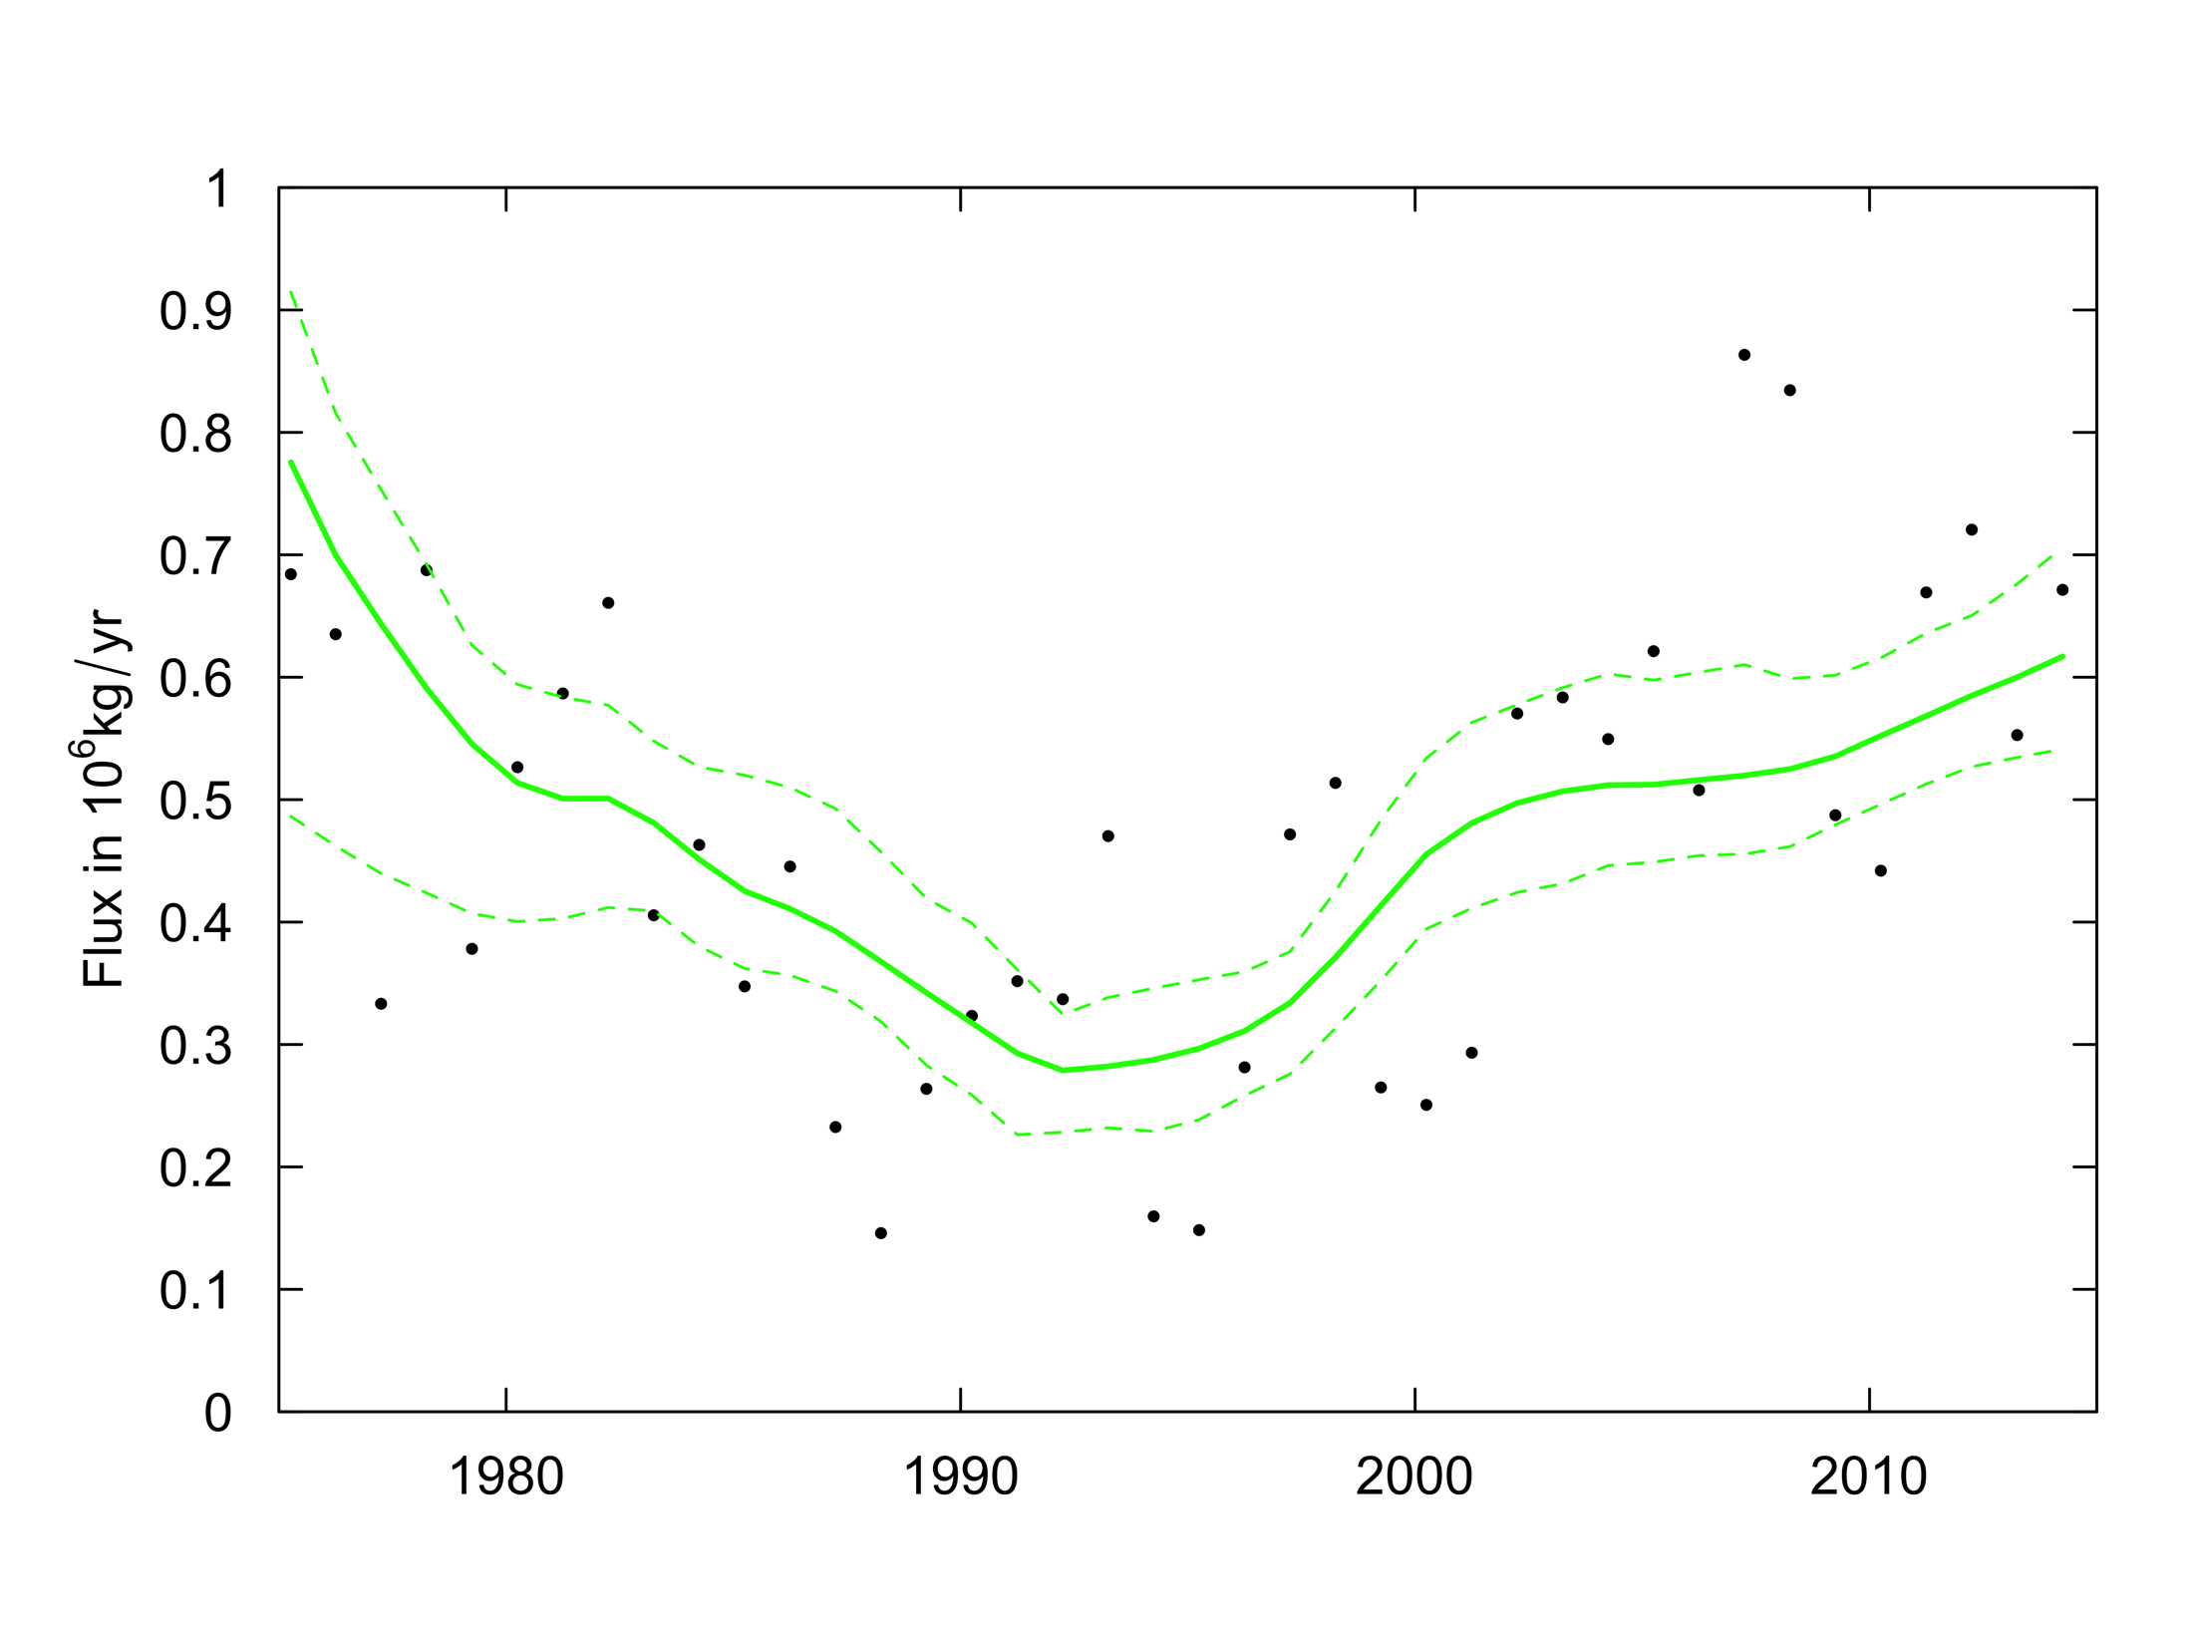
Maumee River, SRP Flux
90% Confidence Intervals, based on 200 bootstrap replicates

Slide 17
We can run the wBT to determine if the trends are equal at two points in time.
Here we run the test, on the Ho that the mean level of the process is different between 1985 and 2017.

Slide 18
> caseSetUp <- trendSetUp(eList = eList, year1 =1985, year2 = 2017, nBoot = 100, bootBreak = 39, blockLength =200)
Sample set runs from 1984 to 2017
year1 = 1985 this is the first water year of trend period
year2 = 2017 this is the last water year of trend period
nBoot = 100 this is the maximum number of replicates that will be run
bootBreak = 39 this is the minimum number of replicates that will be run
> bootOut <- wBT(eList = eList, caseSetUp)
Choptank River near Greensboro, MD Nitrate as N
Water Year
Bootstrap process, for change from Water Year1985 to Water Year2017
data set runs from 1985 to Year 2017
Bootstrap block length in days 200
bootBreak is 39 confStop is 0.7
WRTDS estimated concentration change is 0.47 mg/L
WRTDS estimated flux change is 0.04654 10^6 kg/yr
*********************** 39 iterations of results shown next ***********

Slide 19
Should we reject Ho that Flow Normalized Concentration Trend = 0 ? Reject Ho
best estimate is 0.47 mg/L
Lower and Upper 90% CIs 0.284 0.575
also 95% CIs 0.269 0.590
and 50% CIs 0.426 0.528
* Note p-value should be considered to be < stated value
approximate two-sided p-value for Conc 0.05
Likelihood that Flow Normalized Concentration is trending up = 0.988 is trending down = 0.0125
Should we reject Ho that Flow Normalized Flux Trend = 0 ? Reject Ho
best estimate is 0.04654 10^6 kg/year
Lower and Upper 90% CIs 0.0273 0.0642
also 95% CIs 0.0269 0.0717
and 50% CIs 0.0423 0.0574
approximate two-sided p-value for Flux 0.05
* Note p-value should be considered to be < stated value
Likelihood that Flow Normalized Flux is trending up = 0.988 is trending down= 0.0125
Upward trend in concentration is highly likely
Upward trend in flux is highly likely
Downward trend in concentration is highly unlikely
Downward trend in flux is highly unlikely

Slide 20
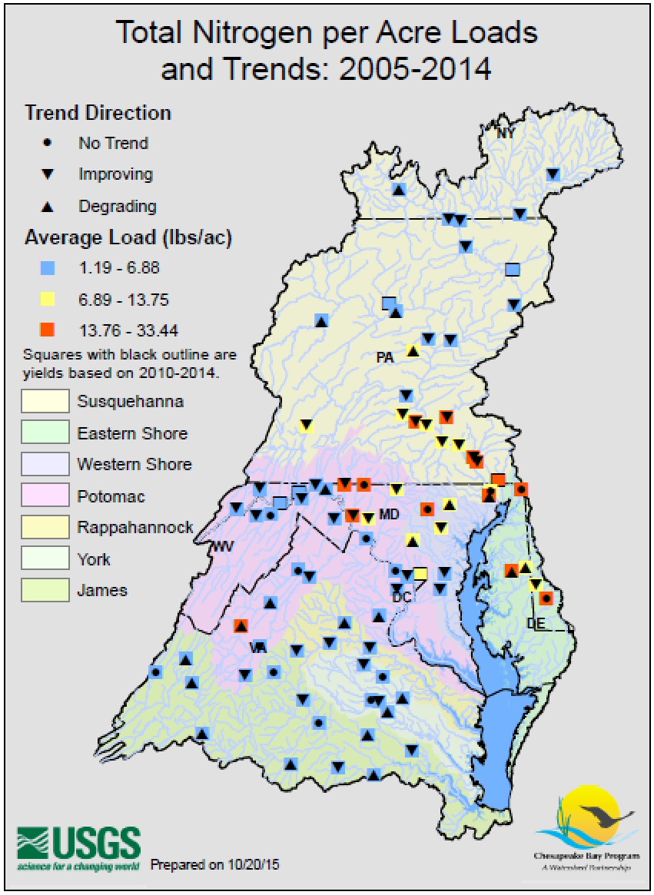
In displays such as this
The indicates likely upward.
The indicates likely downward,
And indicates about as likely up as down (likelihood 0.33 to 0.67)

Slide 21
New thoughts about uncertainty
See American Statistical Association statement on statistical significance and p-values (March 7, 2016)
https://www.amstat.org/asa/files/pdfs/p-valuestatement.pdf
Trend Direction Assessment: Graham McBride, 2019, "Has Water Quality Improved or Been Maintained? A Quantitative Assessment Procedure." Jour. of Environ. Quality
We need to focus on avoiding Type II error (failing to declare a trend when it really does exist)

